Slide 1
Making and demonstrating research and evaluation impact (in an era of austerity)
Sandra Nutley

Slide 2
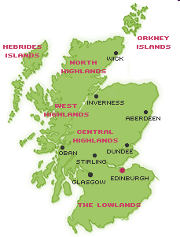

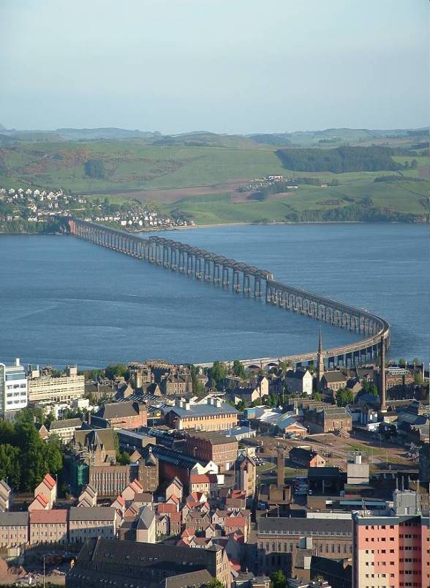



Slide 3
Using Evidence: How research can inform public services
(Nutley, Walter and Davies, Policy Press, 2007)
My knowledge base
Research Unit for Research Utilisation
Developing cross-sector knowledge on research use
Education Healthcare Social Care Criminal Justice
www.ruru.ac.uk

Slide 4

An era of austerity: a UK-centric view?
Yes, but not limited to the UK
Brings the issue of making and demonstrating impact into sharp relieve, especially after the boom years
Australia may not be immune: ‘Some believe that the current boom could end as soon as 2014’ (The Economist 28/5/11)

Slide 5
Impact on research & evaluation: threat or opportunity?
UK: ‘Arguably the role of social research becomes more important to guide practice in an era of austerity than one of affluence’ (SRA 2010)
USA: ‘There seems to be broad [bipartisan] agreement: We need an evidence-based system to guide future budget decisions that assesses the relative performance and impact of all government programs’ (Center for American Progress, July 2011)
Underpinning rationale:
Evidence-based policies and practices ‘more likely to be better informed, more effective and less expensive’ (Campbell et al 2007)

Slide 6

Threat more of a reality in UK
Job cuts for researchers in government
Research and evaluation budgets slashed
Researchers & evaluators having to do more with less
But
Research impact demands have raised status of applied/policy-related research in universities
Politicians still reach for research as a tactic
‘One person's riot is another’s research grant’

Slide 7
My questions
Why has social research and evaluation been viewed as dispensable when the going gets tough?
What challenges need to be tackled in order to increase and demonstrate the impact of research and evaluation?
Some answers in form of 8 emerging lessons

Slide 8

Some reflections
Policy makers and practitioners tend not to recognise influence of research and evaluation
Unrealistic ambitions and expectations
Some persistent problems in supply and demand, and insufficient focus on what happens in between

Slide 9
Recognising research use & impact is hard because ‘policy making’ is complex
SOMETIMES:
clearly defined event
explicit decisions
involving known actors
conscious deliberation
defined policies
policy fixed at implementation
The rational high ground
OFTENTIMES:
ongoing process
piecemeal: no single decision
many actors
muddling through
policies emerge and accrete
shaped through implementation
The swampy lowlands

Slide 10
Research used in many ways
MORE CONCEPTUAL USES
INSTRUMENTAL USES
Knowledge & understanding
Practice & policy changes
Changing attitudes, perceptions, ideas
Awareness
Knowledge
Persuasion
Decision
Implementation
Evaluation &
Confirmation
PROBLEM REFRAMING
The “enlightenment” role of research (Weiss)

Slide 11
Enlightenment use:
promoting new ways of thinking…
Service user engagement…
Importance of informal carers…
Decarceration policies…
The happiness and well-being agenda…
Patient safety…
Harm reduction in substance misuse…
Enhancing self-care…

Slide 12
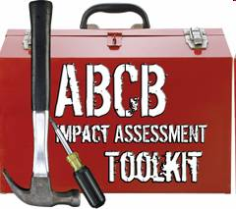
Lesson 1: Pay more attention to tracing research impact
Not been good at revealing and relating persuasive research impact stories – a challenging task
Need to refine our methods and tools:
  Construct a convincing impact narrative: dealing with complexity, attribution and additionality
  Consider conceptual and instrumental impacts (and symbolic use)
  Account for the difference between actual and potential impacts: receptivity of context

Slide 13
Need to be aware of possible unintended consequences
Research and evaluation funds may be increasingly targeted on short term and low risk projects
A tendency to over-emphasise positive and intended impacts, and underplay unintended and dysfunctional consequences
How do we safeguard serendipity, critique and paradigm challenging research and evaluation?

Slide 14
Lesson 2: Set realistic ambitions and expectations about research use
Evidence-informed not evidence-determined policy: value judgements are important
Research and evaluation studies can rarely provide the definitive word
A cautious, ‘experimental’ approach to policy making

Slide 15
Addressing supply, demand, and that in between
Stocks or reservoirs of research and evaluation-based knowledge
Evidence demand in political and professional worlds, and wider society

Slide 16
Supply deficits
Lack of timely and accessible research that addresses policy/practice-relevant questions
Better at understanding and illuminating problems rather than identifying possible solutions
Too much unwitting replication of studies
Paucity of good quality studies of intervention effectiveness (prevention and ‘treatment’ interventions)
Insufficient attention paid to cost-effectiveness
Insufficient mining of secondary data sources
Equivocal attitude to ‘engaged’ research in university research community

Slide 17
Lesson 3: Improve the supply of relevant, accessible & credible evidence… but don’t stop there
Better R&D strategies
Address methodological competency and capacity internally and externally (and incentives)
Revisit research & evaluation commissioning processes
Support synthesis of existing studies
Better dissemination and archiving

Slide 18
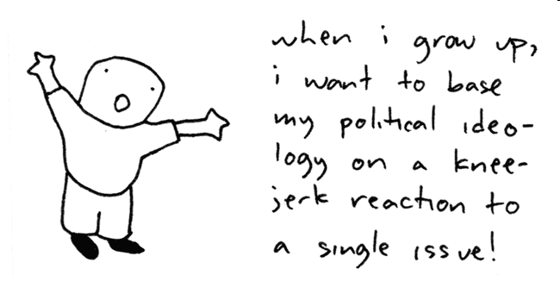
Demand deficits
Research evidence low in politicians’ hierarchy?

Slide 19
Policy Makers’ Hierarchy of Evidence
‘Experts’ evidence (incl. consultants and think tanks)
Opinion-based evidence (incl. pressure groups)
Ideological ‘evidence’ (incl. party think tanks)
Media evidence
Internet evidence
Lay evidence (constituents’, citizens’ experiences)
‘Street’ evidence (urban myths, accepted wisdom)
Cabbie’s evidence
Research Evidence
Source: Phil Davies, 2007

Slide 20
Demand deficits
Research evidence low in politicians’ hierarchy?
Certainly ministerial differences in emphasis
Politicised decision making more likely at times of crisis (Peters 2011)
Practitioners have varying incentives to pay attention to research

Slide 21
Lesson 4: Shape – as well as respond to – the demand for evidence in policy and practice settings
Formal government commitment to an evidence-informed approach
Improve analytical skills of policy makers and practitioners
Address incentives
Work with advocacy organisations to shape context for specific findings

Slide 22
Connecting supply and demand

Slide 23
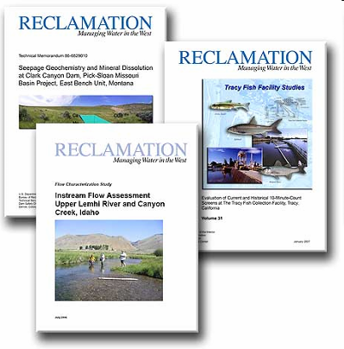


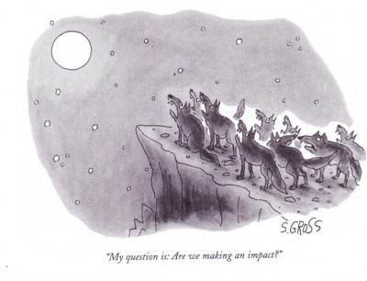

What image best represents how you think about the main challenges?
A
B
C
D
F
G
H
E

Slide 24

Challenge of linking two worlds?
Divergent
  interests, priorities, incentives, language, dynamics
  conceptions of knowledge and time-scales
  status and power
Leading to
  communication difficulties
  mismatch between supply and demand
  rejection and implementation failure
Research
Policy

Slide 25
But many players in research use process
Multiple interests, many connections & pathways to impact
University and college researchers
Research institutes and independent evaluators
Research funders
Think tanks and knowledge brokers
Media
Government analysts
Professional bodies
Audit, inspection and scrutiny regimes
Lobbyists and advocacy groups
Politicians
Civil servants
Loc govt officers
Political advisors
Service providers
Service users
Wider community

Slide 26
Lesson 5: Develop multifaceted strategies to address interplay between supply & demand
Moving away from ideas of ‘packaging’ knowledge and enabling knowledge transfer
– recognising instead:
Players and processes more important than products
Importance of context
Interaction with other types of knowledge (tacit; experiential)
Multi-voiced dialogue
‘Use’ an interactive, non-linear, social & political process

Slide 27
Three generations of knowledge to action thinking
Knowledge transfer
Knowledge exchange
Knowledge integration
Knowledge a product –degree of use a function of effective packaging
Knowledge the result of social & political processes – degree of use a function of effective relationships and interaction
Knowledge embedded in systems and cultures – degree of use a function of effective integration with organisations and systems
Source: Best et al 2008

Slide 28
Generic features of effective practices to increase research impact
Research must be translated - adaptation of findings to specific policy and practice contexts
Enthusiasm- of key individuals - personal contact is most effective
Contextual analysis - understanding and targeting specific barriers to, and enablers of, change
Credibility - strong evidence from trusted source, inc. endorsement from opinion leaders
Leadership - within research impact settings
Support - ongoing financial, technical & emotional support
Integration - of new activities with existing systems and activities

Slide 29

Lesson 6: Recognise role of dedicated knowledge broker organisations/ networks
Three brokerage frameworks
Knowledge management - facilitating creation, diffusion and use of knowledge
Linkage and exchange - brokering the relationship between ‘creators’ and ‘users’
Capacity building - improving capacity to interpret and use evidence, and produce more accessible analytical reports
Based on Oldham and McLean 1997

Slide 30

Lesson 7: Target multiple voices to increase opportunities for evidence to become part of policy discourse
Feeding evidence into wider political & public debate
Deliberative inquiry, citizen juries, etc
More challenging approach for governments – ‘letting go’
More challenging role for researchers and research advocates – contestation and debate

Slide 31
Lesson 8: Evaluate (KE) strategies to improve research use and learn from this
Rarely done in any systematic way
KE an immature discipline: under-theorised and limited empirical evidence
Underdeveloped evaluation frameworks and tools

Slide 32


Conclusions (or delusions/illusions?)
No room for complacency
Making an impact on public policy and practice is challenging at all times
Crises tend to unsettle existing patterns of policy making and create opportunities for innovation and learning
Researchers & evaluators need to provide compelling ideas and persuasive evidence in innovative and efficient ways

Slide 33

Sandra.Nutley@ed.ac.uk
Thank You
www.ruru.ac.uk

Slide 34
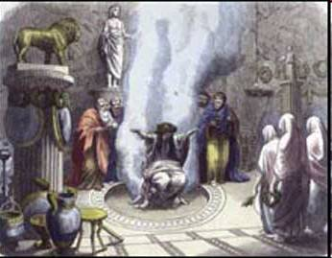
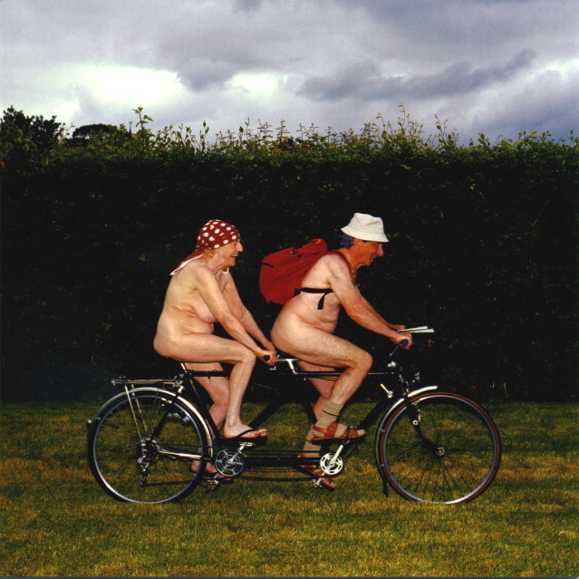
Any questions?
☑
☒

